Slide 1
What is Data Wrangling?
RX 319
Introduction to Healthcare Analytics

Slide 2
Learning Objectives
Describe how data gets “wrangled”.
Identify when data cleaning is necessary.
Explain a few data wrangling steps in dplyr.
2

Slide 3
Data Wrangling gets your data ready for analysis
Analyze!
Clean
Organize
Transform
R for Data Science – Ch.12 “Tidy Data” (Optional)
Collecting and merging data sets
Converting between “wide” and “long” tables
Identifying and handling incorrect or incomplete data (or outliers)
3

Slide 4
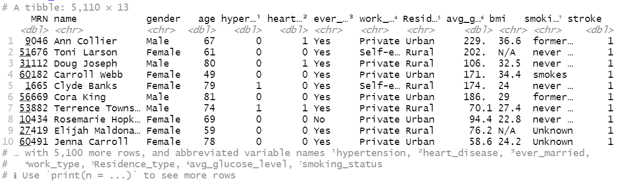
Identifying anomalies
Read in the data
dat <- read_csv(“data.csv”)
Look at the top – are columns marked as “dbl” or “chr” correctly?
dat
dat <- mutate(dat, bmi = as.numeric(bmi))
4

Slide 5
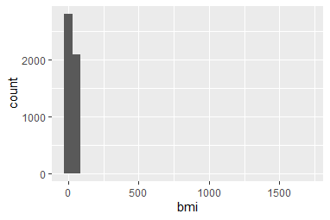
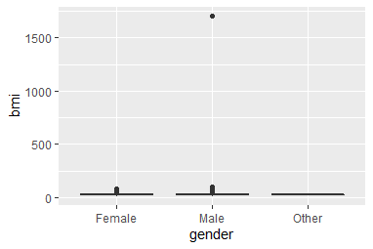
Identifying outliers
Summarize the whole table
summary(dat)
Or just one column
summary(dat$bmi)
Could also use arrange
arrange(dat, desc(bmi))
Histograms and boxplots can help, too
5

Slide 6
Using dplyr to correct anomalies
Filter out rows if needed
dat <- filter(dat, bmi < 500)
Or change the outlier (bonus!)
dat <- mutate(dat, bmi = replace(bmi, bmi > 500, NA))
Best option: get a corrected csv file
6

